Slide 1


JEPPPIAAR ENGINEERING COLLEGE
DEPARTMENT OF COMPUTER SCIENCE AND ENGINEERING
ONLINE LEARNING PLATFORM
Team Leader- Naveen N (310821104062)
Team Member-Roshan Elesius D (310821104080)
Team Member -Sanjay Raj ( 310821104307)
Team Member -Prakash G (310821104305
Supervisor Name : MRS.D.JEEVITHA M.E
ASSISTANT PROFESSOR /CSE

Slide 2

CONTENT
01
INTRODUCTION
02
PROPOSED SOLUTION
03
SYSTEM ARCHITECTURE
04
SET UP INSTRUCTION
05
KEY FEATURES
06
TESTING
07
FUTURE ENHANCEMENT

Slide 3

INTRODUCTION
01
Purpose:
Seamless Education: Ensures smooth online learning.
Connection: Bridges students, teachers, and administrators.
Centralized Platform: Facilitates efficient interaction and management.
OBJECTIVE
02
User Roles:
Seamless Learning
User Connection
Flexible Access
Streamlined Management
Secure Platform
Scalability
Students: Enroll in courses, track progress, earn certificates.
Teachers: Create and manage courses.
Administrators: Oversee platform operations and users.
03
Core Features:
Course Management: Creation, updates, and tracking.
Secure Access: User authentication and role-based permissions.
Payment Processing: For enrollment transactions.

Slide 4


PROPOSED SOLUTION
The proposed solution is an online learning platform that allows administrators to manage courses and enables students to explore, learn, and track their progress. Key features include:
•Secure user authentication and role management.
•Course creation, updating, and deletion by administrators.
•Course browsing and progress tracking for students.

Slide 5











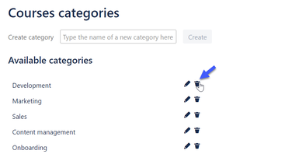
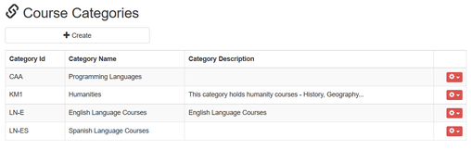
SYSTEM ARCHITECTURE
FRONTEND
•Built with React for a dynamic user interface
BACKEND
•Node.js for server-side logic and API endpoints.
STUDENT
TEACHER
ADMIN
DATABASE
•MongoDB for robust data management.
AUTHENTICATION
•JWT (JSON Web Tokens) for secure user authentication.
CREATE COURSES
MANAGE COURSES FOR ENROLLED STUDENT
ENROLL COURSE

Slide 6



SYSTEM ARCHITECTURE OVERVIEW
BACKEND
DATABASE
FRONTEND
Core Functions:
User Authentication, Course Management, Enrollment Tracking, Payment Processing, Certificate Generation.
Business Logic:
Data Processing, Validation, Frontend-Backend Communication.
Backend Interaction:
Frontend Requests, Data Processing, System Operations Management.
Data Storage:
Stores User Data, Course Data, Enrollment Data, Payment Data, and Certificate Data.
Data Integrity:
Ensures reliable and secure storage and retrieval of data.
Scalability:
Manages growing user and course data efficiently as the platform scales.
User Interaction:
Students, teachers, admins
Core Pages:
Registration/Login, Dashboards, Course Catalog, Course Details, Certificates.
Key Functionality:
Data Display, Data Collection, Backend Processing.

Slide 7
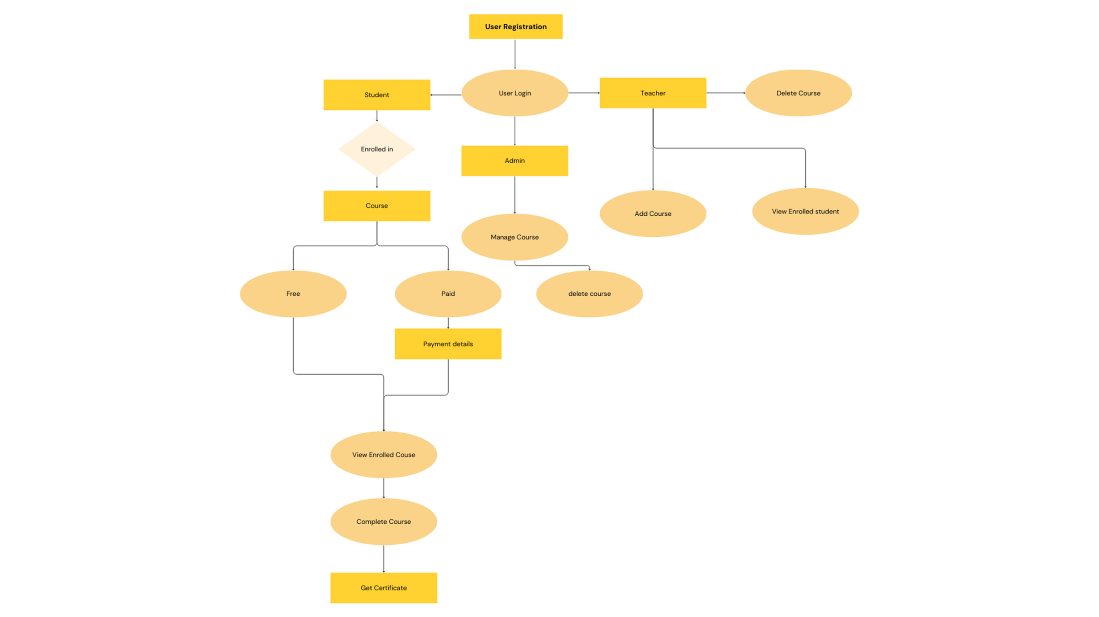

WORKFLOW
www.reallygreatsite.com

Slide 8
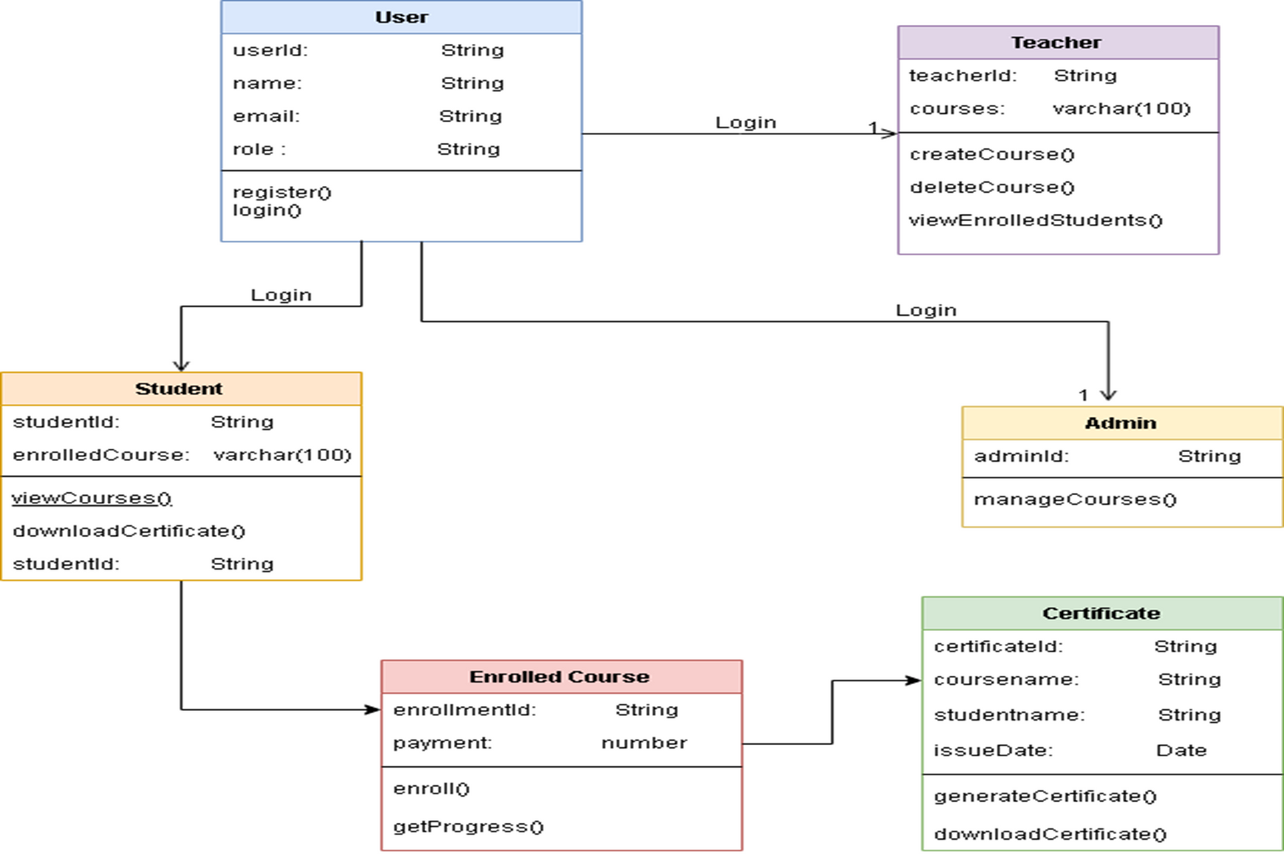
CLASS DIAGRAM
www.reallygreatsite.com

Slide 9
SETUP INSTRUCTION
Prerequisites:
Install Dependencies:
npm install
API, Client, Socket
Node.js
MongoDB
Environment Setup:
Commands to Run:
Frontend: Run npm start in the client directory.
Backend (API): Run npm start in the api directory.
WebSocket (Socket): Run npm start in the socket directory
.env, database URL, ports, keys.

Slide 10


BACKEND
ERROR HANDLING
Express Middleware
ROUTING
Middleware functions in Express.js are functions executed during the request-response cycle
Express uses a robust routing mechanism to manage and define endpoints and their respective HTTP methods.
Express allows centralized error handling to capture issues across the application.
Uses:
Logging: Tracks and logs requests and responses.
Authentication: Verifies user credentials and access permissions.
Error Handling: Catches errors in the middleware chain and passes them to the error-handling middleware.
Request Parsing: Parses incoming requests (e.g., JSON or URL-encoded data)
Errors are passed down the middleware chain using the next() function.
Custom error-handling middleware processes the errors and sends appropriate responses.
2022
Endpoints: Specify URLs and the corresponding controller functions.
Methods: Handles GET (fetch data), POST (create data), PUT (update data), and DELETE (remove data).

Slide 11
KEY FEATURES
Seamless User Experience
Course Management
Easy navigation for students, teachers, and admins.
Mobile and desktop compatibility for flexible learning.
Teachers can create, update, and manage courses.
Students can easily browse and enroll in courses
Personalized Dashboards
Progress Tracking and Certification
custom views for each user type (students, teachers, admins).
Displays relevant data (enrolled courses, progress, upcoming lessons)
Tracks student progress and awards certificates upon course completion.

Slide 12
TESTING
Postman:
API Testing, Test Endpoints.
Jest:
Unit Testing, Testing Framework.
Manual Testing:
Evaluate UI, Backend Integration.
Issues and Resolutions:
Identify Issues, Fix Bugs, Improve Functionality.

Slide 13
FUTURE ENHANCEMENT
Mobile App Development:
AI Tutors and Assistants:
Additional Payment Methods:
Create a mobile app for better accessibility, performance, and offline functionality.
2022
Use AI to provide real-time assistance, explanations, and guidance to students.
Integrate digital wallets and bank transfers for diverse payment options.

Slide 14

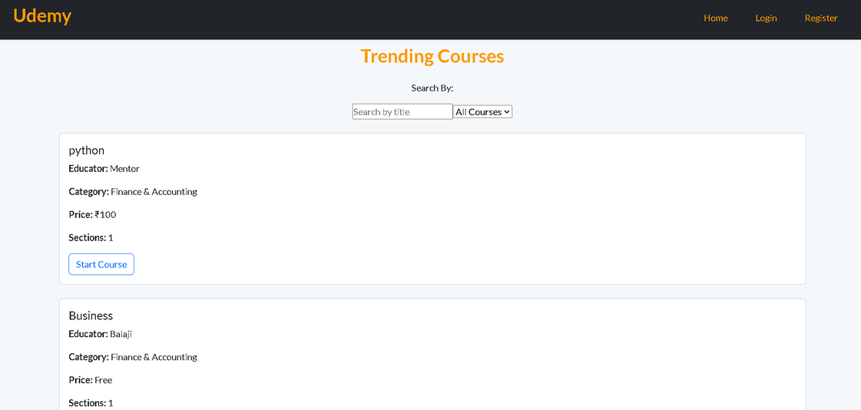
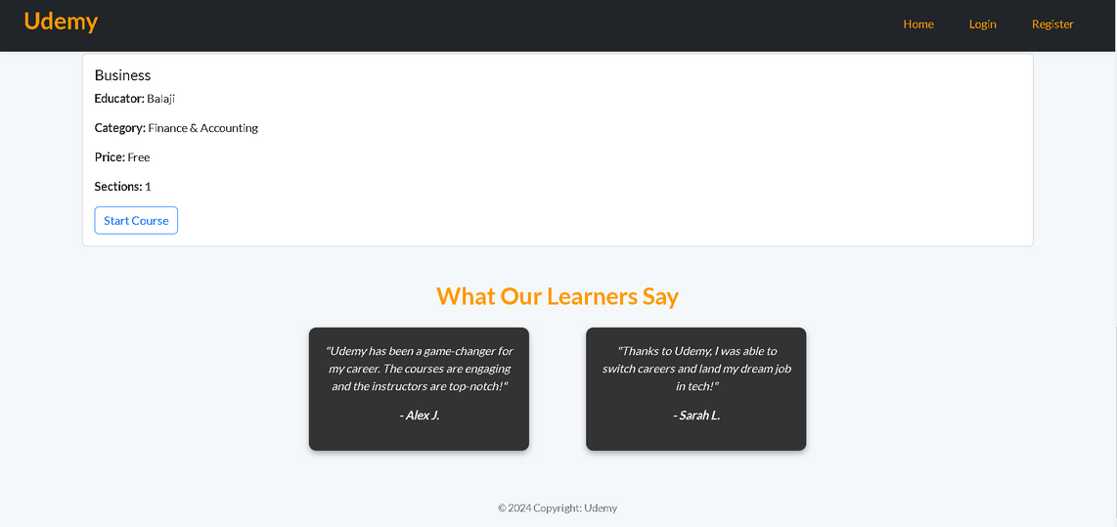
DASHBOARD

Slide 15
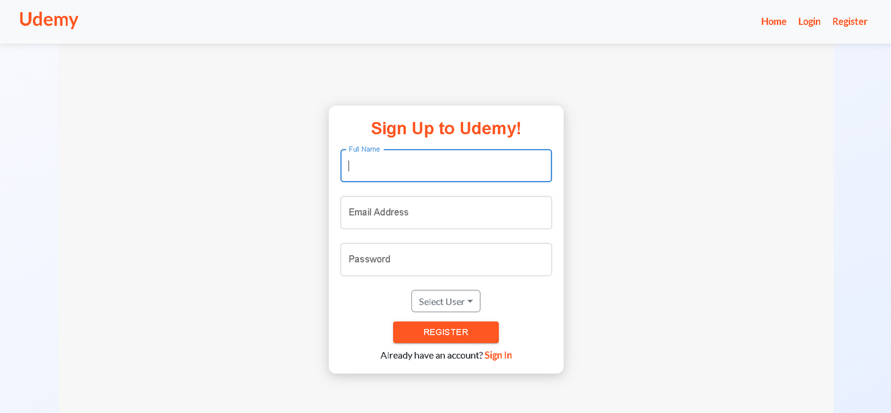
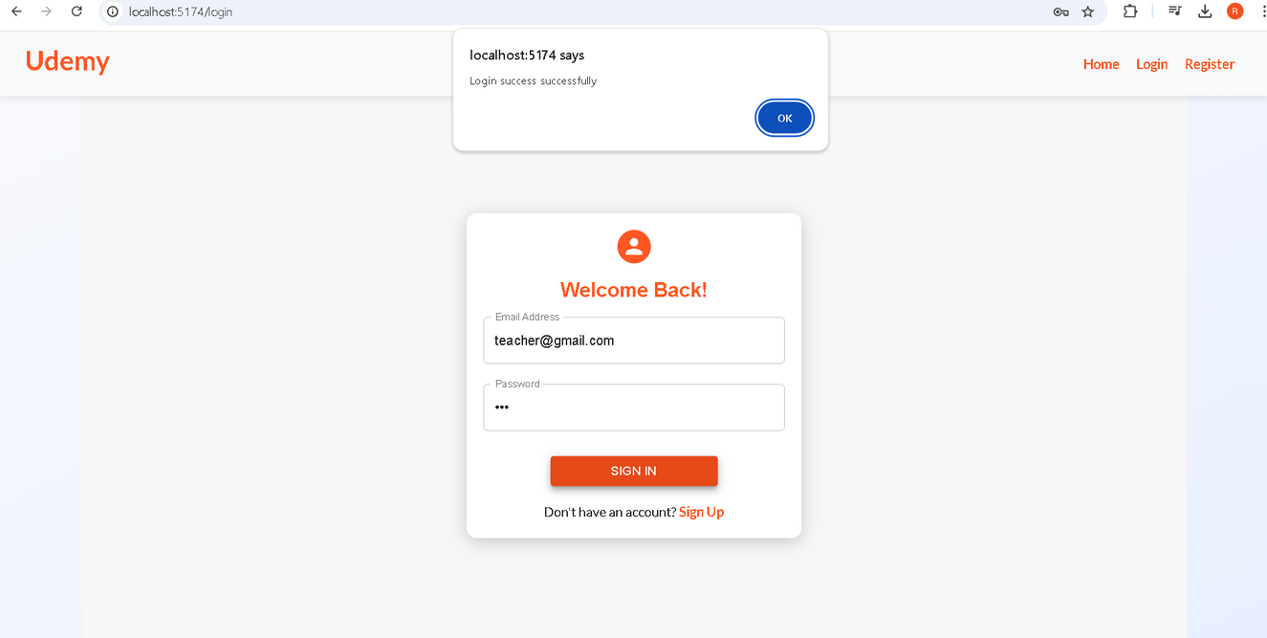
REGISTER
LOGIN

Slide 16
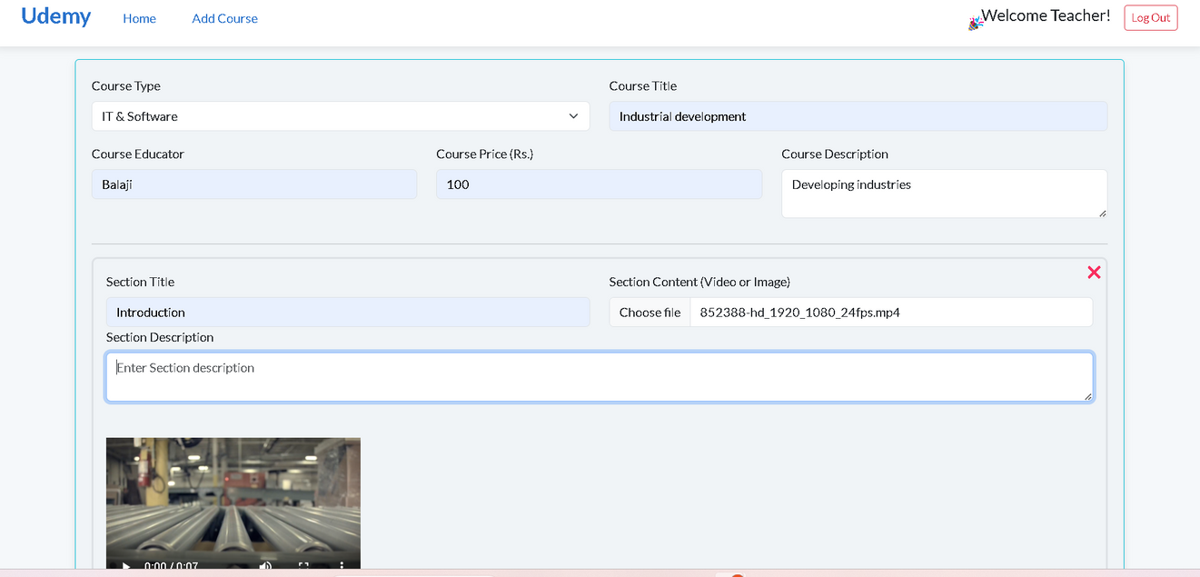
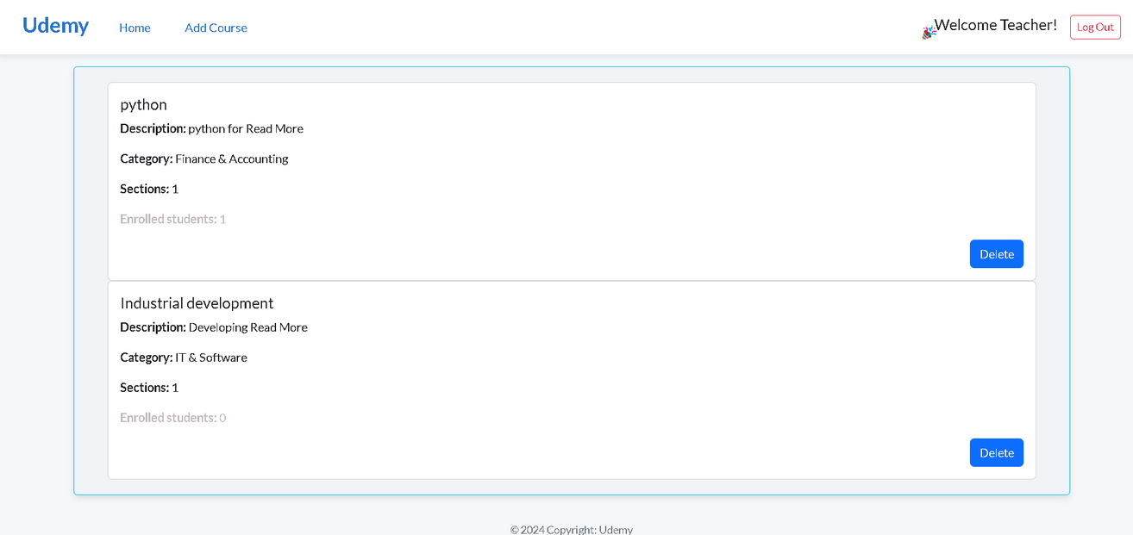
TEACHER DASHBOARD

Slide 17
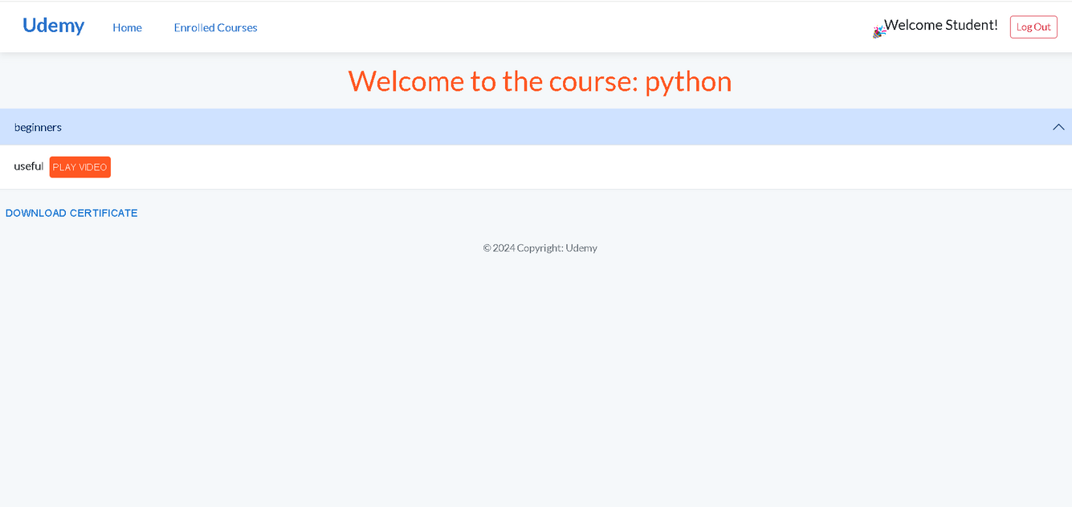
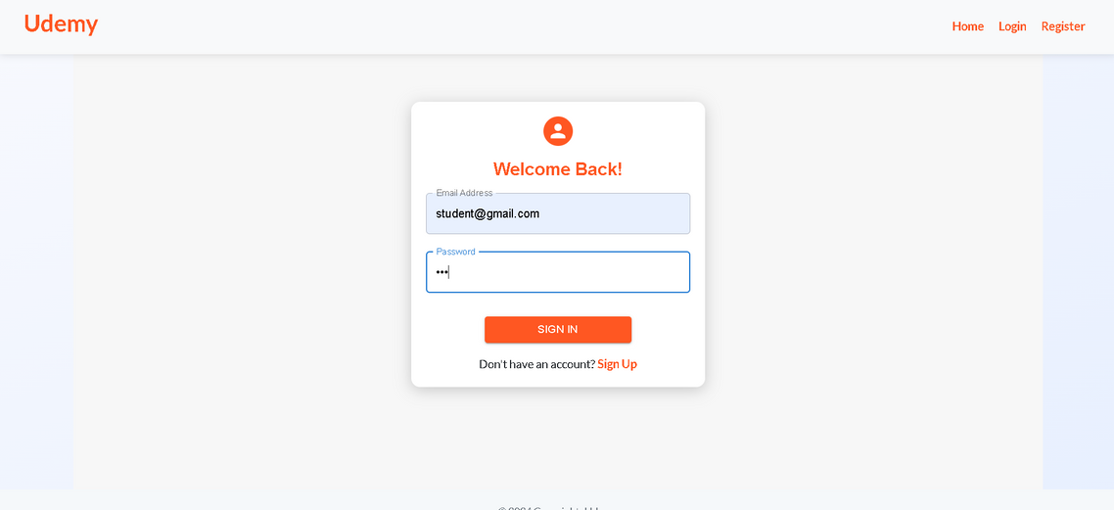
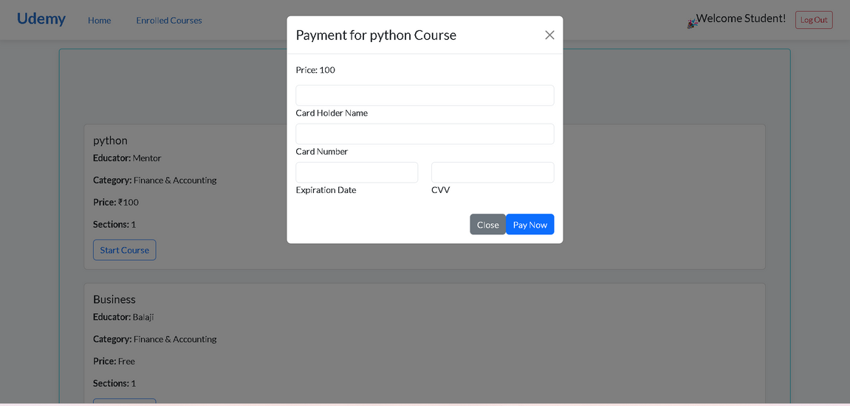
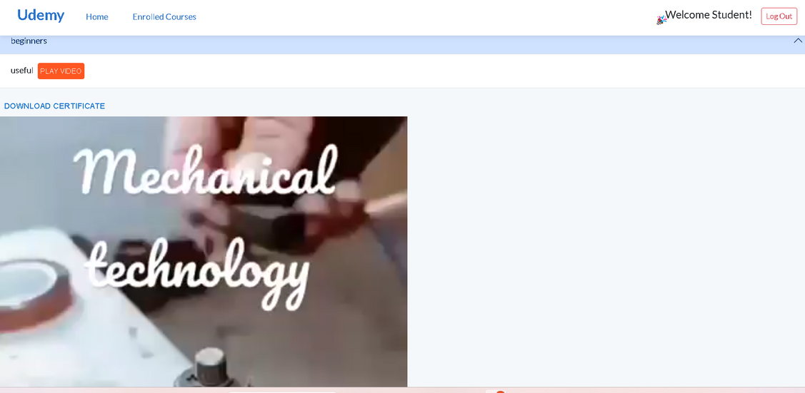
STUDENT DASHBOARD

Slide 18
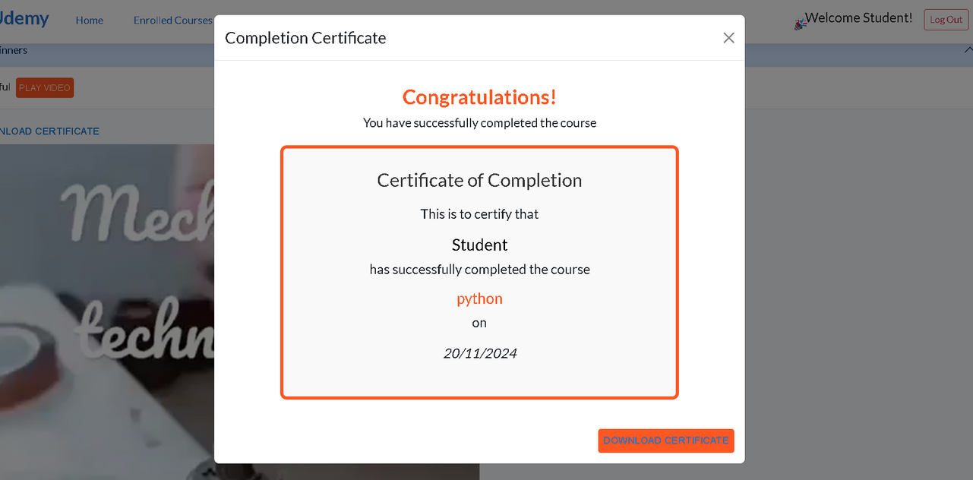
STUDENT COMPLETED COURSE

Slide 19
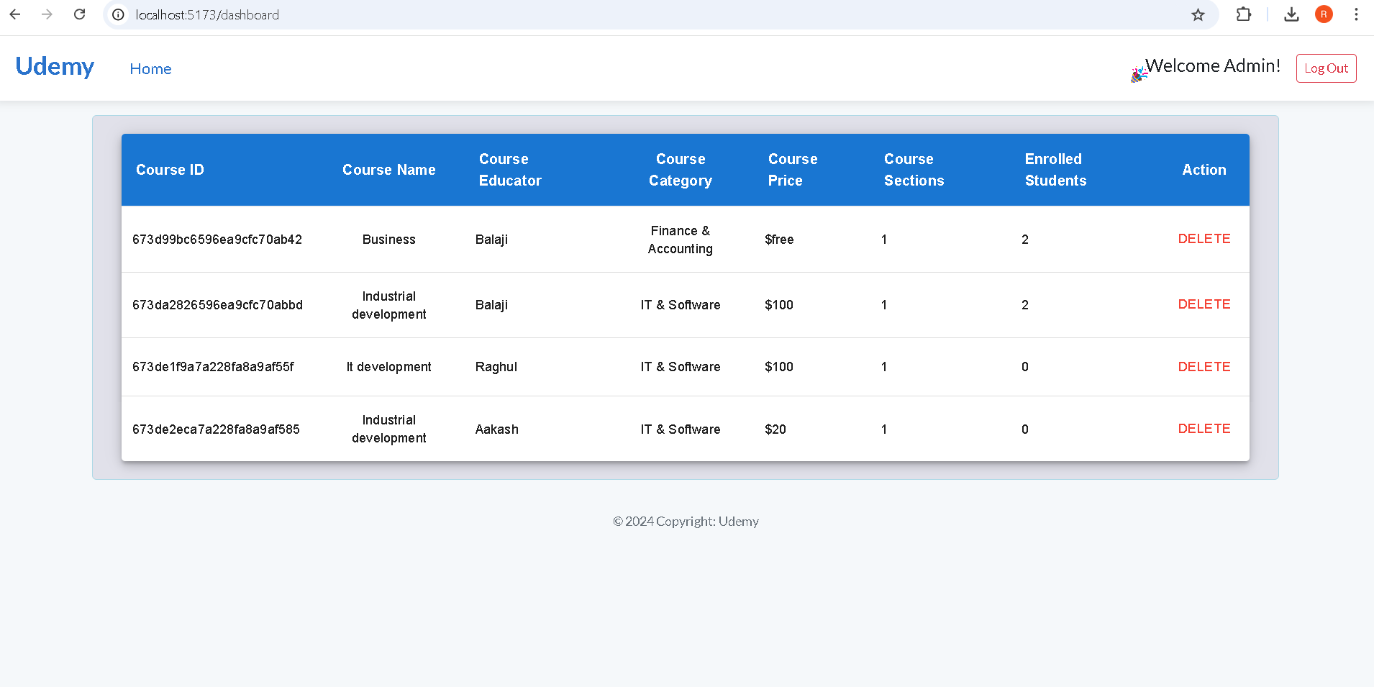
ADMIN DASHBOARD

Slide 20

THANK YOU

